Slide 1
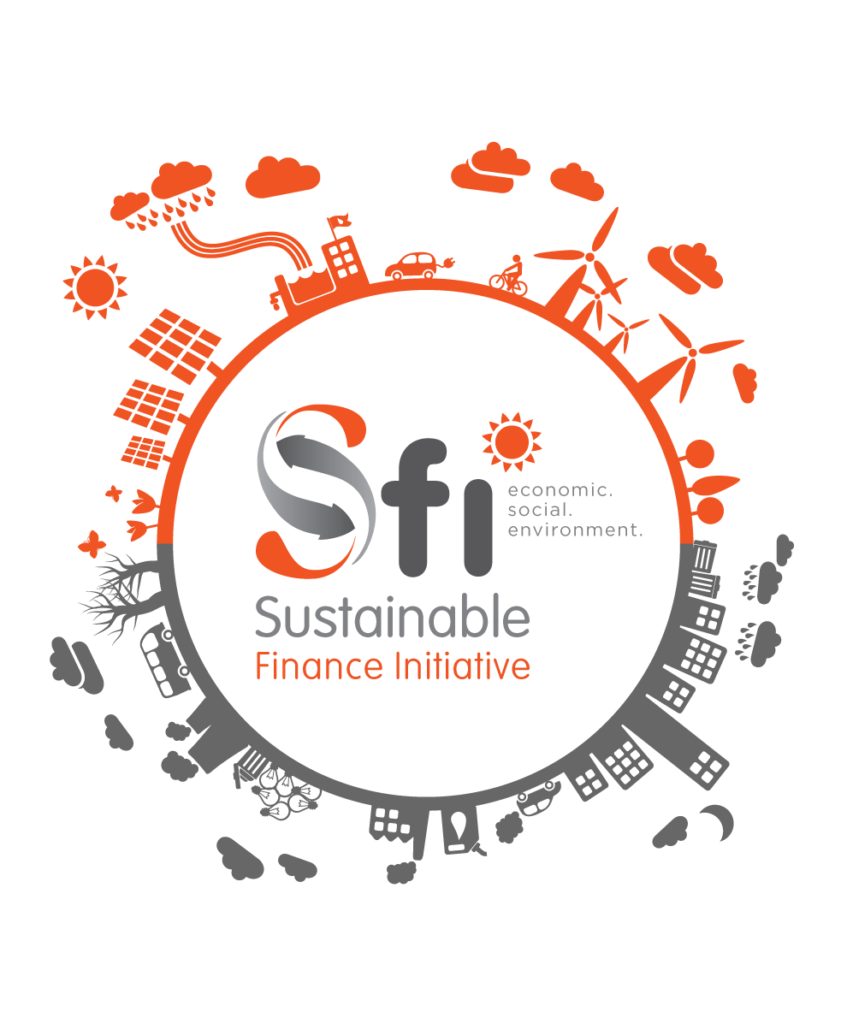
2nd Annual SFI CEO Roundtable
31st March 2015
Serena Hotel
PROGRAM
7:00am Arrival & Breakfast
7:30am to 9:20am
Welcome by KBA CEO, Habil Olaka
Remarks by Joshua Oigara, KBA Chair & KCB Group CEO
SFI Guiding Principles Presentation, Discussion & Adoption by Nuru Mugambi
Panel Discussion:
Lamin Manjang, SCB Kenya CEO & Regional CEO
Eric Kaleja, DEG Regional Director for East Africa
Linda Broekhuizen, FMO Chief Investment Officer
John Nzau, CBA Assistant GM - Special Projects
Moderator: Melissa Makwarimba, Consultant
9:20am to 9:30am
Closing Remarks
Group Photo

Slide 2
We Will Cover…
Process
Proposals
Principles & Standards
Governance
Adoption of Proposals

Slide 3
“If you want to walk fast,
walk alone.
If you want to
go far,
walk together”
African Proverb

Slide 4
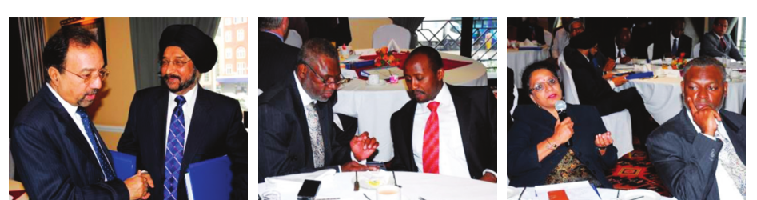

Slide 5
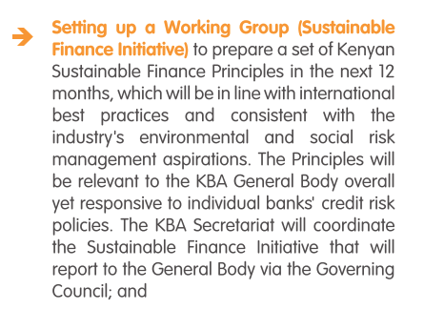
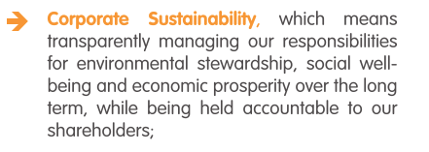
CEO Roundtable Commitments September, 2013

Slide 6
SFI Structure & Mandate
SFI Working Group Banks
Bank of Africa (Kenya)
Commercial Bank of Africa
Co-operative Bank of Kenya
Equity Bank
Gulf African Bank
Habib Bank
I&M Bank
Jamii Bora Bank
KCB Group
NIC Bank
National Bank of Kenya
Standard Chartered Bank
Work Streams
Sustainable Finance Principles
Capacity Building
The Green Economy (Research on the Drivers of the Real Economy)
SFI Convener: Kenya Bankers Association

Slide 7
SFI Principles
#SustainableFinance

Slide 8
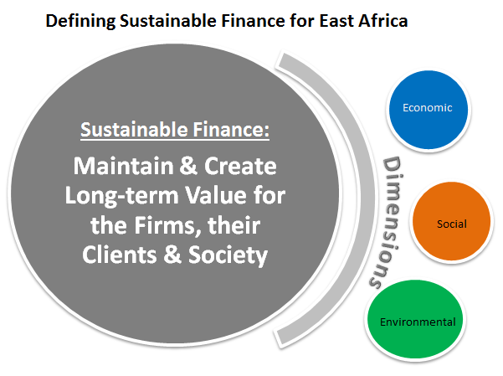

Slide 9
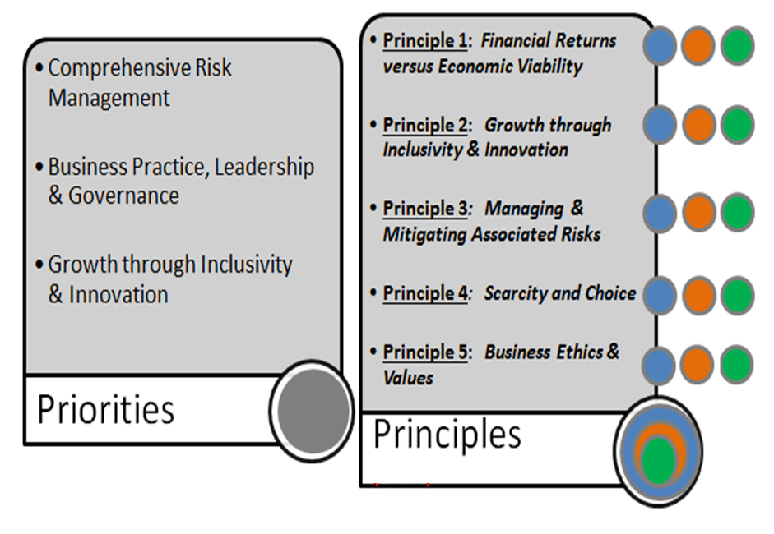

Slide 10
Principle 1: Financial Returns versus Economic Viability
Financial institutions should consider both financial returns and economic viability of their activities.
Economic viability should be factored into the decision making process, particularly in the financing of commercial activities.
The Guiding Principle is that financial viability is a necessary but not a sufficient condition for sustainable economic development.

Slide 11
Principle 2: Growth through Inclusivity & Innovation
Financial sector players seek to grow and enhance service delivery for the markets they currently serve, as well as reach out into diversified markets.
The Guiding Principle is that financial institutions in pursuit of growth should innovate and leverage on existing and emerging technology to reach potential markets while economically empowering communities.

Slide 12
Principle 3: Managing & Mitigating Associated Risks
Financiers are materially affected by social (including political) and environmental risks -- despite the fact that these risks may be considered as indirect.
Firms should seek to mitigate social and environmental risks associated with their financing activities through client engagement and effective policies and risk assessment procedures.
Firms should actively measure and report on the MATERIAL financial impact of these risks to their business performance.

Slide 13
Principle 4: Resource Scarcity and Choice
Financial firms have a duty to ensure optimal management of financial resources (capital; efficient utilization of resources).
Financiers also have a duty to ensure an economy’s natural capital is not depleted by their financing activity.

Slide 14
Principle 5: Business Ethics & Values
Ethical practice, efficiency, productivity and waste minimisation should be fostered from the leadership and enabled by adequate governance structures.
The leadership of financial institutions should ensure the organisation to deliver returns in the long term, and in a responsible manner.

Slide 15
SFI Standards
#SustainableFinance

Slide 16
Sustainable Finance Standards
Principle 1: Financial Returns versus Economic Viability Firm level process for monitoring macroeconomic impact to business strategy
Principle 2: Growth through Inclusivity & Innovation Product & process innovation strategies to tap new market segments; grow market share Aligning growth with country development agenda (Vision 2030) Consumer Protection & Customer Education

Slide 17
Principle 3: Managing & Mitigating Associated Risks Establish Environmental & Social Risk Management System Tie E&S to credit analysis process w/ risk categorisation Bank policy on exclusions (based on economic, social & environmental risk) Mitigation approach (client advisory service) In-house E& S resource person(s) supported by consultant/firm Dispute resolution mechanism for social/environ risks

Slide 18
Principle 4: Resource Scarcity and Choice How the bank operates (HQ, Branch, Fleet, Agents) – energy efficiency (carbon footprint), waste reduction Ensure bank isn't financing activity that depletes the country’s natural capital (national heritage, environment, etc.) Enable customers to be more resource efficient

Slide 19
Principle 5: Business Ethics & Values Reorient strategic planning (starting at the board level) Sustainability & Integrated Reporting (material non-financial risk disclosures) Reporting of SFI Principles Adoption & Implementation (bank Values & Policies)

Slide 20
SFI Governance & Support
GOVERNANCE
KBA General Body (CEO Roundtable)
KBA Governing Council
SFI Working Group
12 Nominated Banks & KBA Secretariat
Industry Implementation of Principles & Self Regulation
Capacity Building Program
Green Economy Opportunities (Green Bond, credit lines, etc.)
Advisory Committee (formal)
External Stakeholders (private & public sector, CBK)
Industry Support
Joint Programs
Lobby & Advocacy (Regulations & Policy)
SFI Compliance Reporting
Industry Award Scheme
Sector wide Initiative

Slide 21
For Adoption:
SFI Guiding Principles
Governance
Self Regulation
Compliance Reporting

Slide 22
Next Steps & Roadmap
Adoption of SFI Guiding Principles & Proposal on Governance
KBA Member Banks (March 2015)
Establishment of SFI Governance Framework/ TORs (May/June 2015)
KBA Secretariat & Working Group
Workshop for Financial Sector Stakeholders (June 2015)
KBA Secretariat, Working Group & Advisory Committee
KBA Capacity Building Program Launch (June/July 2015)
KBA Secretariat & Consultants
Funding Partners
KBA Member Banks
Financial Sector Stakeholders
SFI “Catalyst” Awards (November 2015)
KBA Secretariat & Advisory Committee

Slide 23
Next Steps & Roadmap
2016
Bank Training & Participation (Ongoing)
SFI Implementation Reporting (July/August 2016)
KBA Secretariat, Working Group & Advisory Committee
3rd CEO Roundtable on SFI (September 2016)

